Slide 1

Объектно-Ориентированное Программирование Проф. Мануель Маццара Проф. Джюйонг Ли Проф. Бертран Мейер С материалом из курса ЭТХ Цюрих «Введние в Программирование»
1ая Лекция: Приветствие и Обзор (Бертран Мейер)

Slide 2
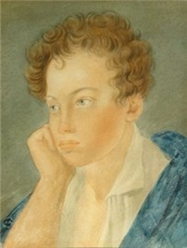
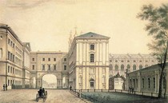
Прецедент
19 октября 1825 Роняет лес багряный свой убор, Сребрит мороз увянувшее поле, Проглянет день как будто поневоле И скроется за край окружных гор. Пылай, камин, в моей пустынной келье; А ты, вино, осенней стужи друг, Пролей мне в грудь отрадное похмелье, Минутное забвенье горьких мук.
Печален я: со мною друга нет, С кем долгую запил бы я разлуку, Кому бы мог пожать от сердца руку И пожелать веселых много лет. Я пью один; вотще воображенье Вокруг меня товарищей зовет; Знакомое не слышно приближенье, И милого душа моя не ждет.

Slide 3
Object-Oriented Programming Prof. Manuel Mazzara Prof. Jooyoung Lee Prof. Bertrand Meyer With material from the ETH Zurich course “Introduction to Programming”
Lecture 1: Welcome and overview (Bertrand Meyer)

Slide 4
Goals of the course
After successfully taking this course, you will:
Know the key concepts of programming
Be able to tackle many different programming problems
Master the concepts of object-oriented programming
Master a programming language: Eiffel
Know basic concepts of design, implementation and maintenance of software systems (“software engineering”).

Slide 5
Source of this course
Designed after the course “Introduction to Programming” at ETH Zurich
(taught every year since 2003, ≅ 3500 students)

Slide 6
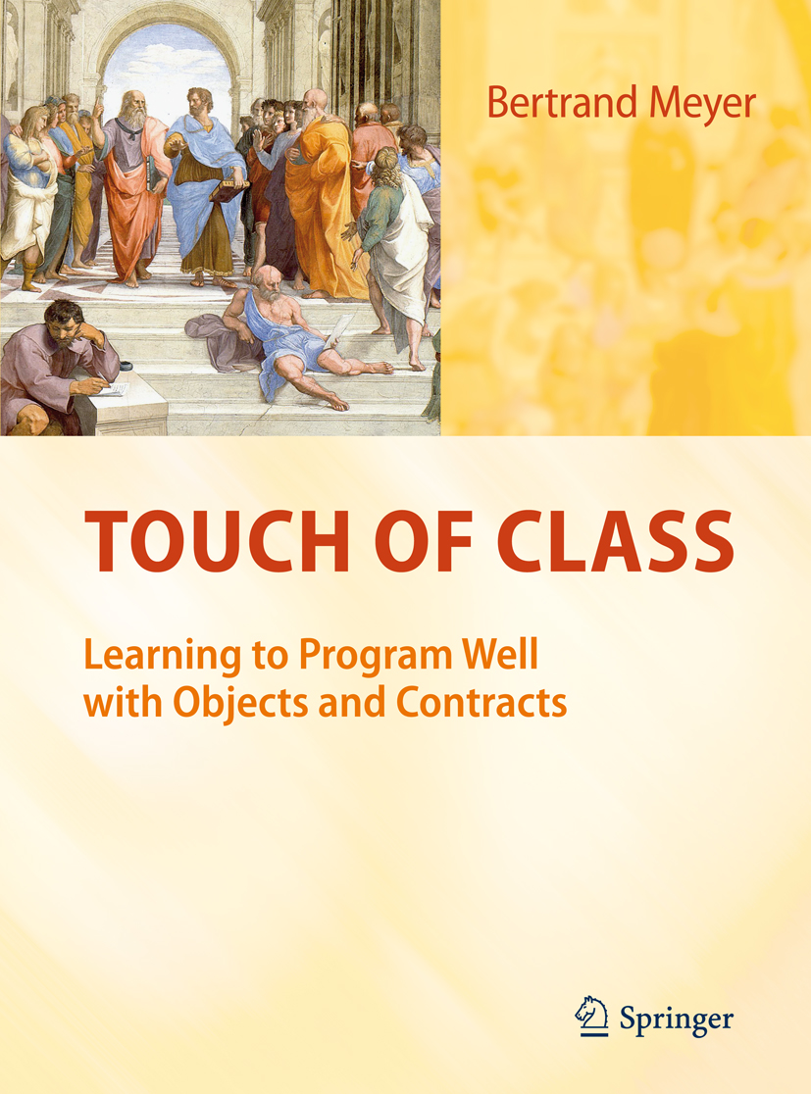

The textbook

Slide 7
Teaching programming: some critical concepts
Specification vs implementation, information hiding, abstraction
Notation
Syntax vs validity vs semantics
Change
Recursive reasoning
Structure
Classification
Complexity & impossibility
Reuse
Algorithmic reasoning
Function vs data
Typing
Scaling up
Static vs dynamic
Invariant
Complexity

Slide 8
The software
The exercises rely on the Traffic “library”
Application domain: Transportation system in a city (Paris or Zurich is used as an example)
You will need (later on) to download:
EiffelStudio
Traffic

Slide 9
Why this approach?
Many software issues become really tough for big systems
With other approaches, in an intro course, you only see small programs
We give you lots of software; use it as model & inspiration
You learn to use software through abstract interfaces (also known as contracts)
You go from consumer to producer: outside-in
Traffic is graphical and fun!
You should at the end be able to understand all of it.
Then you can add to it yourself

Slide 10
Object-oriented programming
Source: Simula 67 language, Oslo, mid-sixties
Spread very slowly in the seventies
Smalltalk, developed at Xerox PARC in late seventies, made O-O hip by combining it with visual technologies
Spread quickly in 1990s through O-O languages like Objective C, C++, Eiffel, Java, C...
Dominant today

Slide 11
About Eiffel
First version 1985, constantly refined and improved since
Focus: software quality, especially reliability, extendibility, reusability
Emphasizes simplicity
Used for mission-critical projects in industry
Based on concepts of “Design by Contract”.
International standard (ISO)

Slide 12
Why use Eiffel?
Simple, clean O-O model
Design by Contract mechanisms
Enables you to focus on concepts, not language
Little language “baggage”
Good development environment (EiffelStudio)
Portability: Windows / Linux / Mac
Realism: not an “academic” language
Prepares you to learn other O-O languages, e.g. C++, Java, C# if you need to
We are teaching programming, not a programming language

Slide 13
Why not Java?
First Java program:
class First {
public static void main(String args[])
{ System.out.println("Hello World!"); } }
You’ll understand when you grow up!
Do as I say, not as I do

Slide 14
First Eiffel program
class
PREVIEW
inherit
ZURICH_OBJECTS
feature
explore
-- Show city info and route.
do
-- “To be filled in (by you!)”
end
end

Slide 15
Why not Java?
Why not C++?
Why not Ruby?
Why not Python?
Why not C#?
Why not C?
Why not Fortran?
Why not Cobol?
…

Slide 16
Finding a job
You will know all the important programming languages
Good employers do not look for specific skills but for strong engineering abilities
Lots of people can write programs (in fact, about 24 million of them)
Employers look for people who can write good programs

Slide 17
Topics
What is software?
Objects & programs
Interfaces and the notion of class
Logic and contracts
The run-time model: object creation, references
Describing syntax
Control structures
Inheritance
Genericity
Recursion
Data structures
Event-driven programming & agents
Topological sort
Intro to software engineering

Slide 18
The industry of pure ideas

Slide 19
Software engineers build machines
You can’t touch, kick or drop our machines: they’re immaterial
But they are machines anyway
We call them programs or systems
To operate (or run or execute) a program you need a physical machine: a computer
Computers and related devices: hardware
Programs and associated intellectual value: software

Slide 20
Software everywhere
Banking: manage millions of accounts
Trading: decide to sell or buy
Transportation: control trains, track planes...
Modern cars have > 10 millions of lines of code
Travel: air, train, hotel reservations
Communication: phones, Internet, …
Government: manage taxes, track laws...
Health care: keep health record, control devices
Education
Entertainment
Information
etc.

Slide 21
Computers
Computers are universal machines. They execute the program that you feed them
The only limit is your imagination
The good news:
Your computer will do exactly what your program says

Slide 22
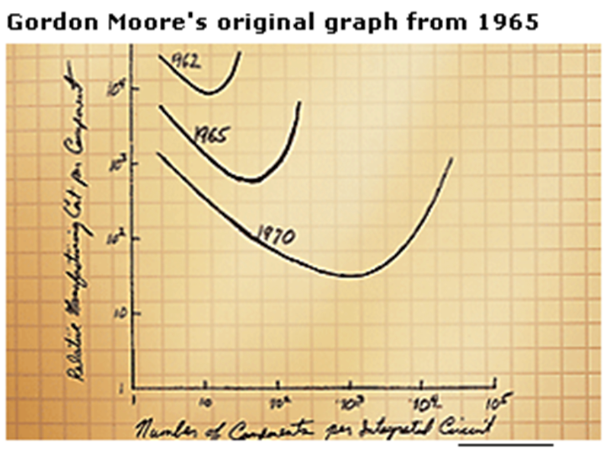
Moore’s “Law”
Approximate doubling of computing power, for comparable price, every eighteen months
(Is this what Moore’s law says?)
(No: approximate doubling of the number of transistors)

Slide 23
Moore’s “Law”
Approximate doubling of computer power, for comparable price, every eighteen months
Speed of Intel processors
3.8 GHz
Pentium IV: 1.3 GHz
1 GHz
(1 Hertz = 1 clock cycle per second)
100 MHz
Pentium: 133 MHz
80486: 50 MHz
80386: 33 MHz
10 MHz
to 1 GHz: 26 years
from 1 to 2 GHz: 8 months
1 MHz
8008: < 1 MHz
1970
1980
1990
2000

Slide 24
Common myths and excuses
“Computers are intelligent”
Fact: Computers are neither intelligent nor stupid. They execute programs devised by humans. These programs reflect the intelligence of their authors.
The basic computer operations are extremely elementary (store this value, add these two numbers…).
“The computer has crashed”
“The computer doesn’t allow this”
“The computer lost your record”
“The computer messed up your record”

Slide 25
Computers don’t make mistakes *....
Programs don’t make mistakes either
Programmers do make mistakes
*Actually, hardware can malfunction, but this is much more rare than program errors

Slide 26
Computers
Computers are universal machines. They execute the program that you feed them
The only limit is your imagination
The good news:
Your computer will do exactly what your program says
It will do it very fast
The bad news:
Your computer will do exactly what your program says
It will do it very fast
and your carefulness
“To err is human, but to really mess things up takes a computer”

Slide 27
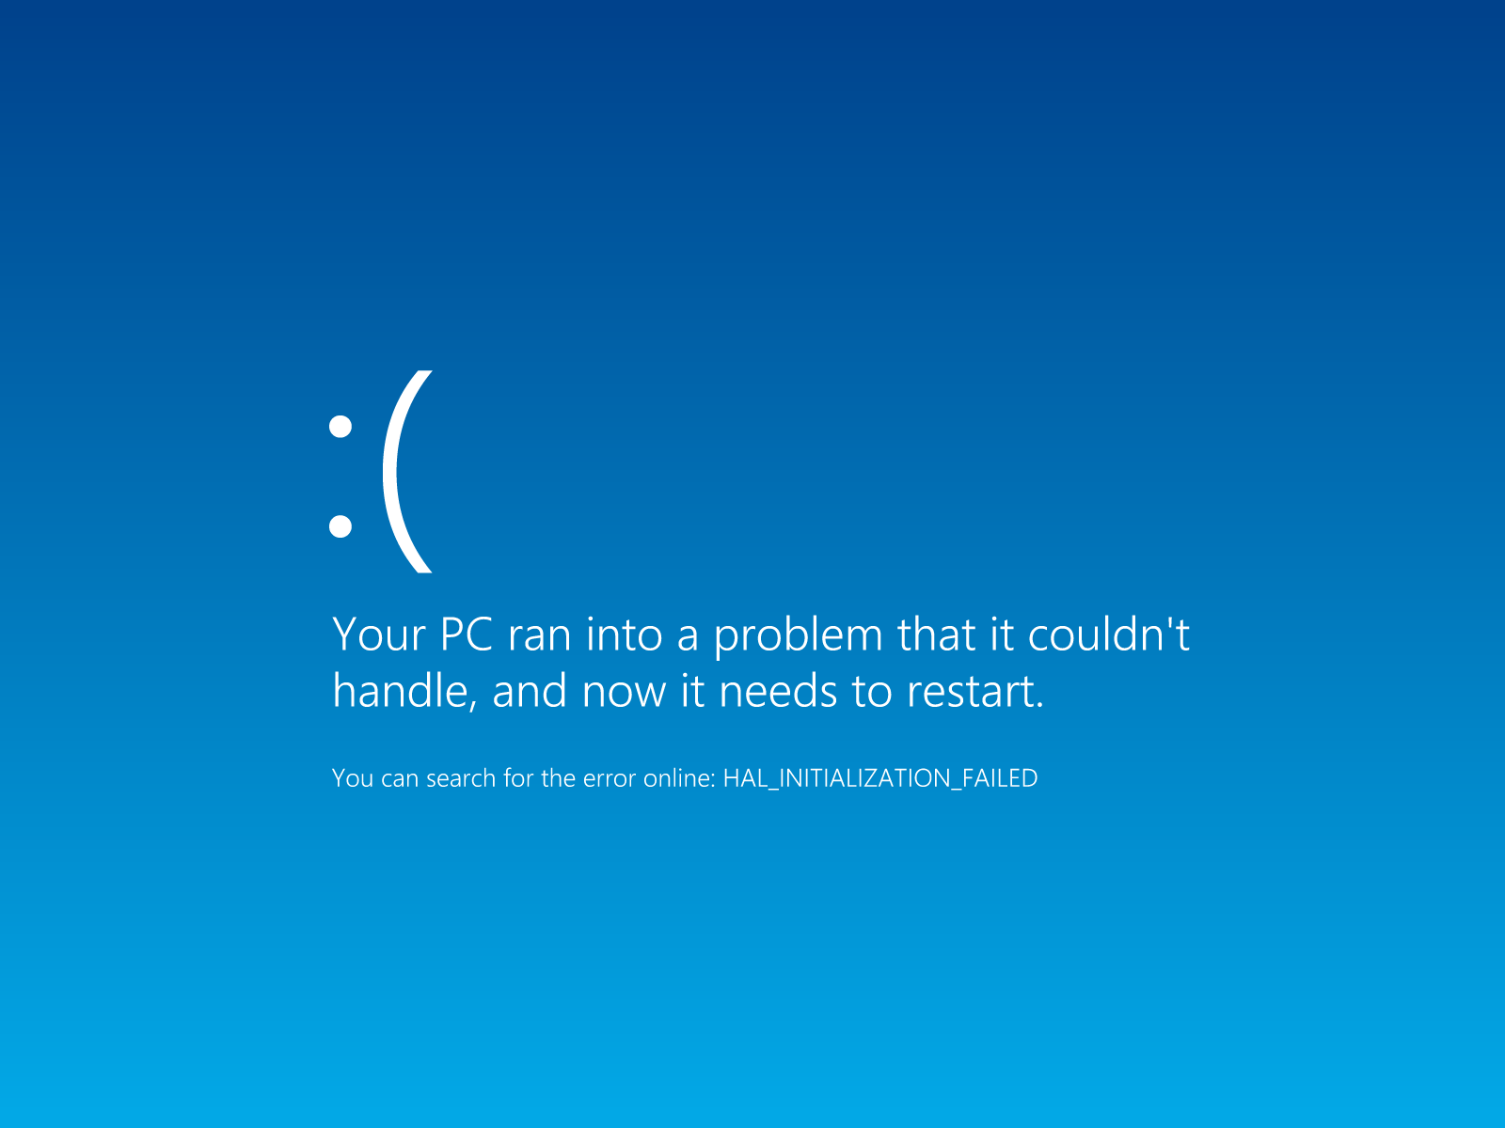
The “Blue Screen Of Death”

Slide 28
Writing software is tough
Programs “crash”
Programs that don’t crash don’t necessarily work
Incorrect programs have killed people, e.g. in medical devices
Ariane 5 rocket: $10 billion lost because of a simple program error
Programmers are responsible for the correct functioning of their programs
The purpose of this course is to teach you not just programming but good programming

Slide 29
Learning to program well

Slide 30
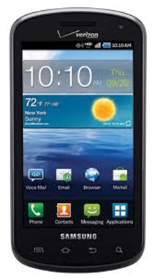
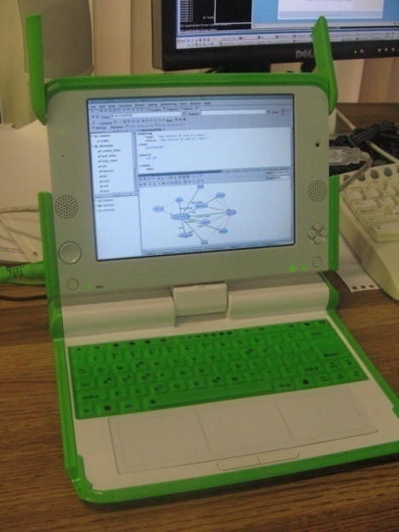
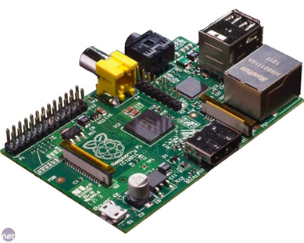
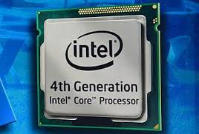
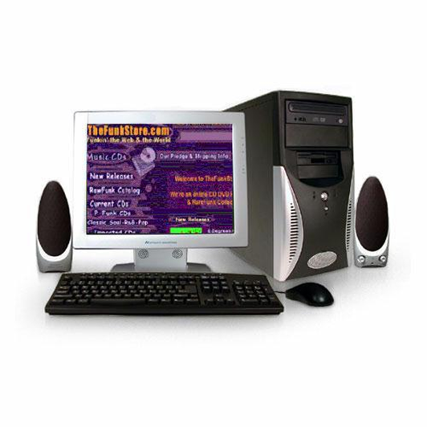
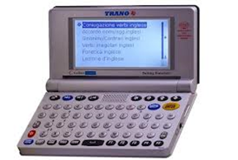
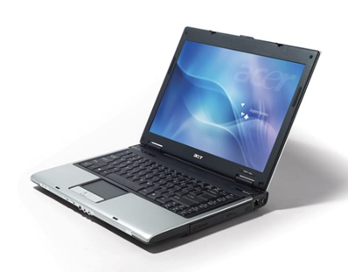
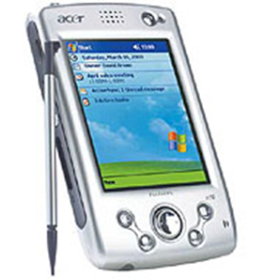
Computers come in all sizes, colors, flavors

Slide 31
Software Engineering
Writing software that’s
Correct Does what it’s supposed to!
Extendible Easy to change!
Readable by humans!
Reusable Don’t reinvent the wheel!
Robust React appropriately to errors
Secure Defeat attackers

Slide 32
Operating systems: source size
Debian 3.1: 213!
Lines of code (millions)
Debian 2.2: 55
50
Vista: 50
Windows XP: 45
40
Windows 2000: 40
30
Red Hat 7.1: 30
20
Windows 98: 18
Windows 95: 15
Red Hat 6.2: 17
Solaris 7: 12
10
Windows NT: 4 M
Windows 3.1: 3 M
1990
1995
1998
2000
Linux: 10 K
2001
2006
1992
Unix V7: 10K

Slide 33
Writing software is tough
It is difficult to get a program right
Trial-and-error approach very inefficient

Slide 34
Writing software is fun
Design and build your own machines
Exert your creativity and imagination
Programs save lives and help make the world better
Experience the feeling of a program that you wrote, and that works

Slide 35
Topics for today and next week
Objects
Classes
Command and queries
Information hiding

Slide 36
Our first program!
Our program is designed to:
Mark the position of the stations “Central” and “Polyterrasse” on the map of Zurich
Highlight the trolley line
Animate a predefined route

Slide 37
A class text
Class: a software machine
The class name
class
PREVIEW
inherit
ZURICH_OBJECTS
feature
explore
-- Show city info and route.
do
-- “To be filled in (by you!)”
end
end

Slide 38
A convention
For long names, use underscores “_”
ZURICH_OBJECTS
Polybahn_line_number
We do not use “CamelCase”:
AShortButHardToDeCipherName
but underscores (sometimes called “Pascal_case”):
A_significantly_longer_but_still_perfectly_clear_name

Slide 39
A class text
Software machine
Operations
Extend existing class
class
PREVIEW
inherit
ZURICH_OBJECTS
feature
explore
-- Show city info and route.
do
-- “To be filled in (by you!)”
end
end
Feature declaration
Comment
Feature name
Pseudocode
Keywords have a special role: class, inherit, feature, do, end

Slide 40
Magic?
Class ZURICH_OBJECTS is part of the supporting software
It helps you learn by using predefined facilities (“magic”)
Little by little pieces of the magic will be removed
At the end, the magic will be gone

Slide 41
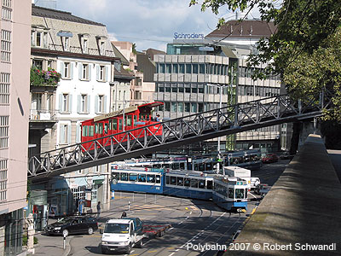
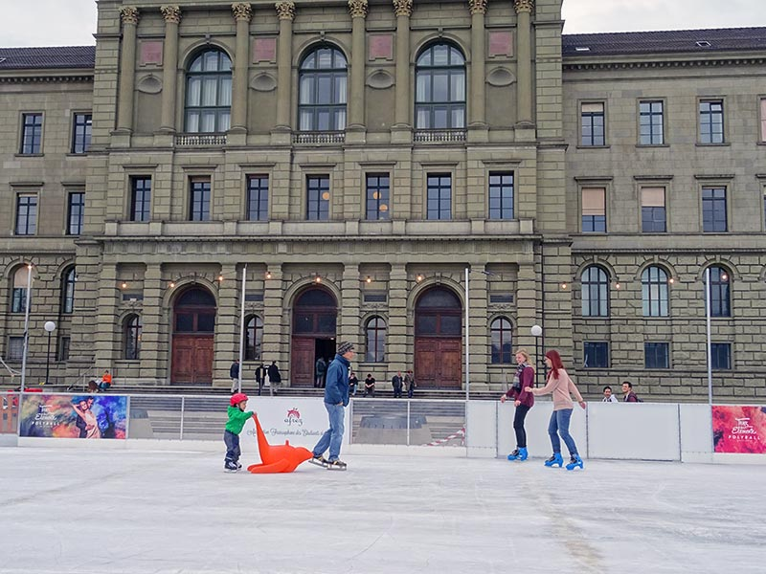
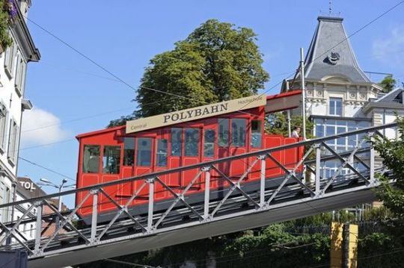
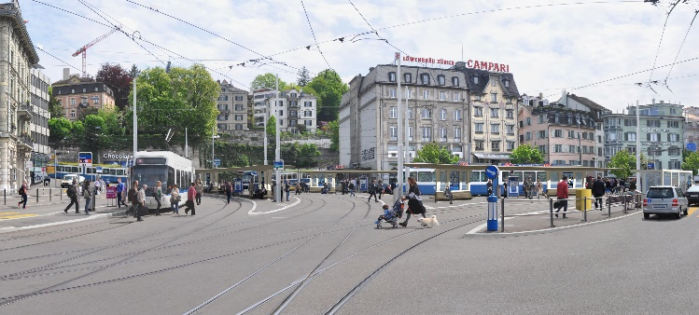
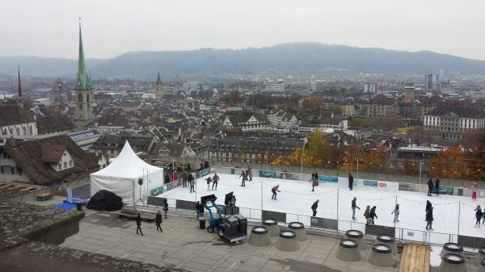
Filling in the feature body
class
PREVIEW
inherit
ZURICH_OBJECTS
feature
explore
-- Explore Zurich.
do
Central_view • highlight
Polyterrasse_view • highlight
Zurich • add_public_transport
Zurich_map • animate
end
end

Slide 42
Program formatting
Between adjacent elements:
break: one or more spaces, “tabs”, “carriage returns”
All kinds of break are equivalent
Typographical variations (boldface, italics, colors) do not affect the effect (semantics) of programs
class
PREVIEW
inherit
ZURICH_OBJECTS
feature
explore
-- Explore Zurich
do
Central_view • highlight
Polyterrasse_view • highlight
Zurich • add_public_transport
Zurich_map • animate
end
end
Breaks
Breaks

Slide 43
Style rule
For indentation, use tabs, not spaces
Use this property to highlight the structure of the program, particularly through indentation
class
PREVIEW
inherit
ZURICH_OBJECTS
feature
explore
-- Explore Zurich
do
Central_view • highlight
Polyterrasse_view • highlight
Zurich • add_public_transport
Zurich_map • animate
end
end
Tabs

Slide 44
Predefined objects
Central_view, Polyterrasse_view, Polybahn_view, Zurich and Zurich_map are names of predefined objects
These objects are defined in the class ZURICH_OBJECTS from which PREVIEW inherits
highlight, add_public_transport, update and animate are features, applicable to these objects

Slide 45
More style rules
Class name: all upper-case
Period in feature call: no space before or after
Names of predefined objects: start with upper-case letters
New names (for objects you define) start with lower-case letters
class
PREVIEW
inherit
ZURICH_OBJECTS
feature
explore
-- Explore Zurich
do
Central_view • highlight
Polyterrasse_view • highlight
Zurich • add_public_transport
Zurich_map • animate
end
end

Slide 46
Object technology
We work with objects
Our style of programming: Object-Oriented programming
Abbreviation: O-O
More generally, “Object Technology”: includes O-O databases, O-O analysis, O-O design...
Software execution is made of operations on objects — feature calls
your_object.your_feature

Slide 47
Feature call
The fundamental mechanism of program execution: apply a “feature” to an “object”
Basic form:
your_object.your_feature
class
PREVIEW
inherit
ZURICH_OBJECTS
feature
explore
-- Explore Zurich
do
Central_view • highlight
Polyterrasse_view • highlight
Zurich • add_public_transport
Zurich_map • animate
end
end
Feature of the call
Object (target of the call)

Slide 48
A distinct mode of expression
Zurich_map • animate
next_message • send
computer • shut_down
telephone • ring
Every operation applies to an object
(the target of the call)

Slide 49
What is an object?
Software notion: machine known through operations applicable to it.
Three kinds of object:
“Physical objects”: describe material objects of modeled system Examples: the Polyterrasse, a car, etc.
“Abstract objects”: describe abstract notions from modeled system Examples: a line, a route, etc.
“Software objects”: describe pure software concepts Examples: “data structures” such as Arrays or Lists
A key attraction of object technology is its modeling power: connect software objects to objects of the problem domain (“model”)
You should not, however, confuse them
In this course, “object” by default means software object

Slide 50
Two views of objects
Start point
“Central”
Tram number
24
Number of stops
2
Endpoint
“Polyterrasse”
Two viewpoints:
1. An object has data, stored in memory.
2. An object is a machine offering operations (features)
The connection:
The operations that the machine provides (2) access and modify the object’s data (1).

Slide 51
Features: commands and queries
Feature: an operation available on certain objects
Three kinds:
Command
Query
Creation procedure (seen later)

Slide 52
Queries
“Central”
Goal: obtain properties of objects
Should not modify the object, or any other
Examples, for “route” objects:
What is the origin (first station) of Route1?
What is the end point of Route1?
How many stations does Route1 have?
Which stations does Route1 traverse?
24
2
“Polyterrasse”

Slide 53
Commands
Goal: produce a change on an object, or several objects
Examples, for “Line” objects:
Append (add at the end) a station to Zurich
Prepend (add at the beginning) a station to Zurich

Slide 54
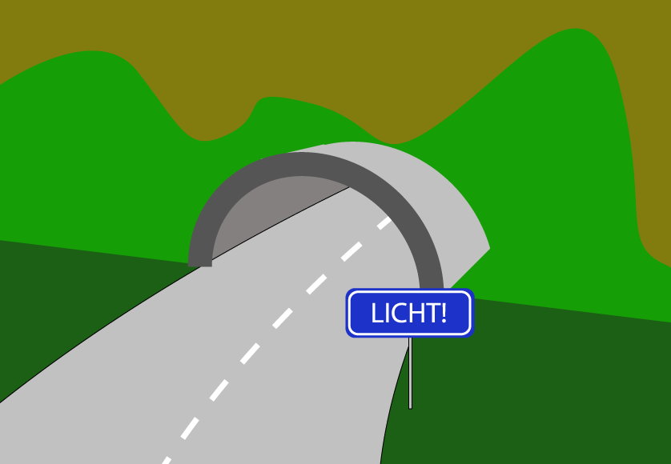
A command

Slide 55
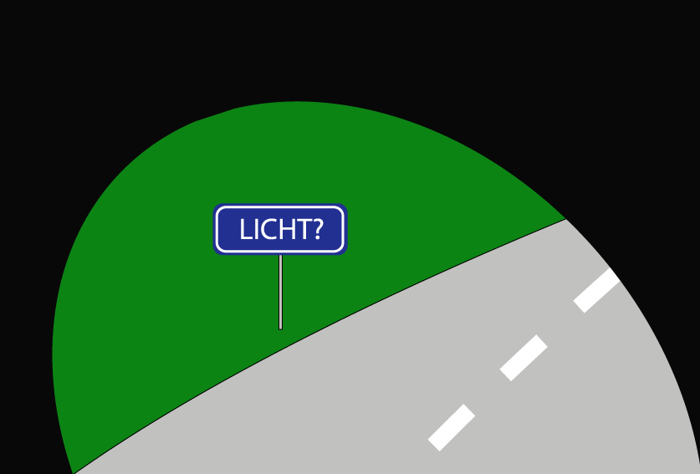
A query

Slide 56
The command-query separation principle
Asking a question
should not change the answer

Slide 57
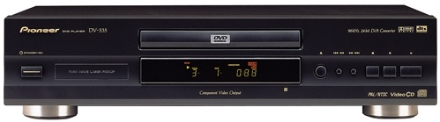
An object is a machine
An executing program is a machine
It’s made of smaller machines: objects
During execution there may be many objects (e.g. millions)

Slide 58
An object is a machine
A machine, hardware or software, is characterized by the operations (“features”) users may apply
animate
first
last
append
prepend
count
stations

Slide 59
Two views of objects
Start point
“Central”
Tram number
24
Number of stops
2
Endpoint
“Polyterrasse”
Two viewpoints:
1. An object has data, stored in memory.
2. An object is a machine offering operations (features: commands and queries)
The connection:
The operations that the machine provides (2) access and modify the object’s data (1).

Slide 60
Objects: a definition
An object is a software machine allowing programs to access and modify a collection of data
Query
Command

Slide 61
Defining and classifying features
A feature is an operation that programs may apply to certain classes of objects.
• A feature that accesses an object is a query
• A feature that may modify an object is a command

Slide 62
Using queries
Queries are as important as commands
Queries don’t “do” anything, but yield a value, e.g. Route1∙origin yields the starting station of Route1
You may work with the return values of queries, e.g. highlight the starting station on the screen

Slide 63
Features may have arguments
Task:
Show the west terminal of Polybahn on the “console” window
You need:
Predefined object Console
Feature output applicable to Console
The object Polybahn
Feature west_terminal returning the west terminal and applicable to Polybahn
The new feature call:
Console.output (Polybahn.west_terminal)

Slide 64
Extending the feature body
class PREVIEW
inherit ZURICH_OBJECTS
feature
explore
-- Explore city and view west terminal of Polybahn
do
Central.highlight
Polyterrasse.highlight
Polybahn.add_transport
Zurich_map.animate
end
end
console.output (Polybahn.west_terminal )

Slide 65
Features with arguments
your_object • your_feature (some_argument)
some_argument is a value that your_feature needs
Example: feature show must know what to show.
Same concept as function arguments in maths:
cos (x)
Features may have several arguments:
x∙f (a, b, c, d ) -- Separated by commas
In well written O-O software, most have 0 or 1 argument

Slide 66
A distinct mode of expression
Zurich_map • animate
next_message • send
computer • shut_down
telephone • ring
Every operation applies to an object

Slide 67
A distinct mode of expression
Zurich_map • animate
next_message • send_to (recipient )
computer • shut_down_after (3 )
telephone • ring_several (10, Loud )
Every operation applies to an object and may take arguments

Slide 68
Scaling up
One of the toughest issues in learning software is to find solutions that work well both “in the small” and “in the large”
That’s the goal for the techniques we teach in this course

Slide 69
An object has an interface
animate
first
last
append
prepend
count
stations

Slide 70
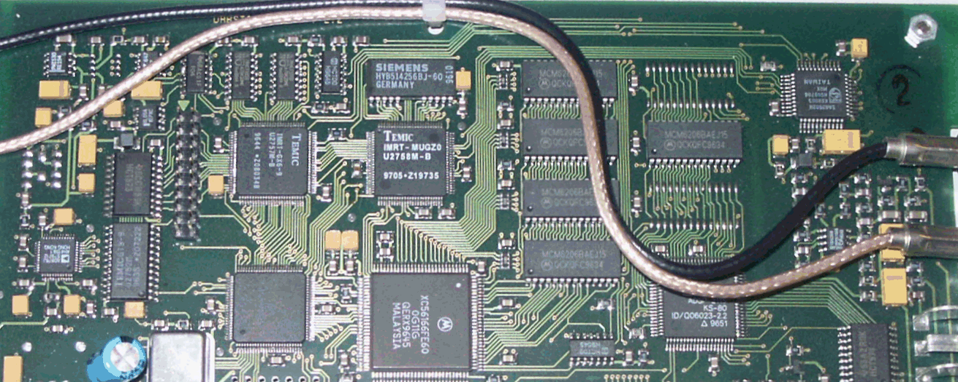
An object has an implementation
animate
first
first
last
append
count
prepend
count
stations

Slide 71
Information hiding
animate
first
last
append
prepend
count
stations

Slide 72
The information hiding principle
The designer of every module must specify which properties are accessible to clients (public) and which are internal (secret)
The programming language must ensure that clients can only use public properties

Slide 73
More about our first example
class
PREVIEW
inherit
ZURICH_OBJECTS
feature
explore
-- Explore Zurich
do
Central • highlight
Polyterrasse • highlight
Polybahn • add_transport
Zurich_map • animate
end
end
“Physical Objects”

Slide 74
Three types of Objects
“Physical Objects”: reflect material objects of the modeled world or system. Examples: the Polyterrasse, a car, etc.
“Abstract Objects”: describe abstract notions of the modeled world. Examples: a (Tram-) line, a route, etc.
“Software Objects”: represent pure software concepts. Examples: “data structures” such as Arrays or Lists

Slide 75
Three kinds of object
Three kinds of object:
“Physical objects”: describe material objects of modeled system Examples: the Polyterrasse, a car, etc.
“Abstract objects”: describe abstract notions from modeled system Examples: a line, a route, etc.
“Software objects”: describe pure software concepts Examples: “data structures” such as Arrays or Lists

Slide 76
More about our first example
class
PREVIEW
inherit
ZURICH_OBJECTS
feature
explore
-- Explore Zurich
do
Central∙highlight
Polyterrasse∙highlight
Polybahn∙add_transport
Zurich_map∙animate
end
end
“Physical Objects”

Slide 77
A better version
class
PREVIEW
inherit
ZURICH_OBJECTS
feature
explore
-- Explore Zurich
do
Central_view∙highlight
Polyterrasse_view∙highlight
Polybahn∙add_transport
Zurich_map∙animate
end
end

Slide 78
Model and Presentation
(Model and View)
Model objects describe elements of a model of the world
Example: Polyterrasse
View objects describe elements of the user interface
Example: Polyterrasse_view

Slide 79
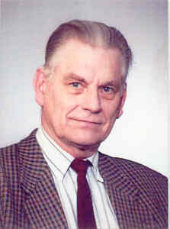
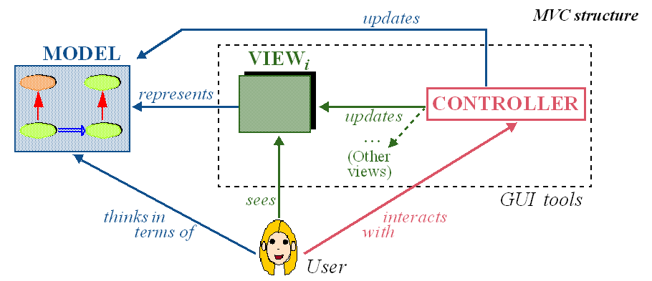
Model-View-Controller
(Trygve Reenskaug, 1979)

Slide 80
What we have seen so far
Basic concepts and constructs of object technology:
Classes (a first view)
Basic program text structure
Objects
Features
Feature call
Feature arguments
Methodological principles:
Command-query separation
Information hiding
Model-view separation

Slide 81
Homework
Read chapters 1 to 3 of Touch of Class

